Slide 1
Assessment Strategy Overview School of Mechanical & Materials Engineering
Assessment Integrity in the Era of Large Language Models: Threats and Opportunities within the UCD College of Engineering & Architecture
June 2023

Slide 2
100,000
513
116,849
modules offered by the
College of Engineering & Architecture in 2022/23
student credits taught* by the
College of Engineering & Architecture in 2022/23
100
29,585
modules offered by the
School of Mechanical & Materials Engineering
in 2022/23
student credits taught* by the
School of Mechanical & Materials Engineering
in 2022/23
74
Level 4
5
Level 5
School of Mechanical & Materials Engineering
number of modules by level
3
Level 1
7
Level 2
11
Level 3
65
5-credit modules offered within the School
8
10-credit modules offered within the School
20
15+-credit modules offered within the School
298
different assessed components within modules offered by the School of Mechanical & Materials Engineering
in 2022/23
ME Mechanical Engineering
flagship course offered by the
School of Mechanical & Materials Engineering
Examination
most common assessment type used within modules
offered by the School of Mechanical & Materials Engineering
in 2022/23
Practical Examination
least common assessment type used within modules
offered by the School of Mechanical & Materials Engineering
in 2022/23
*Student Credits Taught = Module ECTS Credits × 2022/23 Enrolled Students

Slide 3
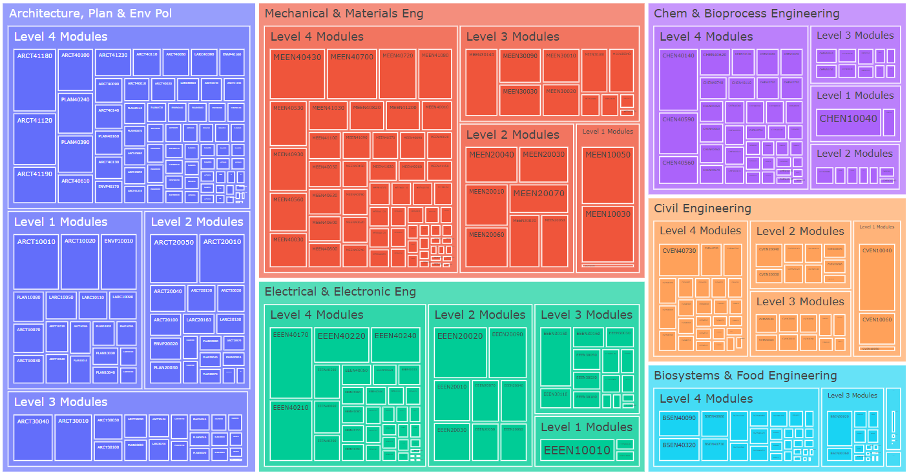
College of Engineering & Architecture – Modules by School
2022/23 Academic Year – Modules Weighted by Student Credits

Slide 4
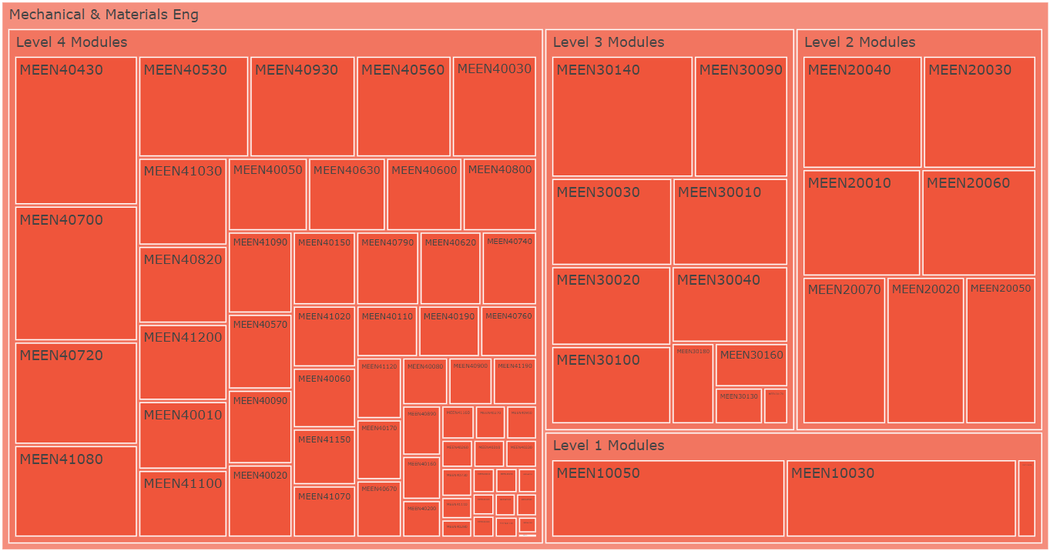
School of Mechanical & Materials Engineering Modules
2022/23 Academic Year – Modules Weighted by Student Credits

Slide 5
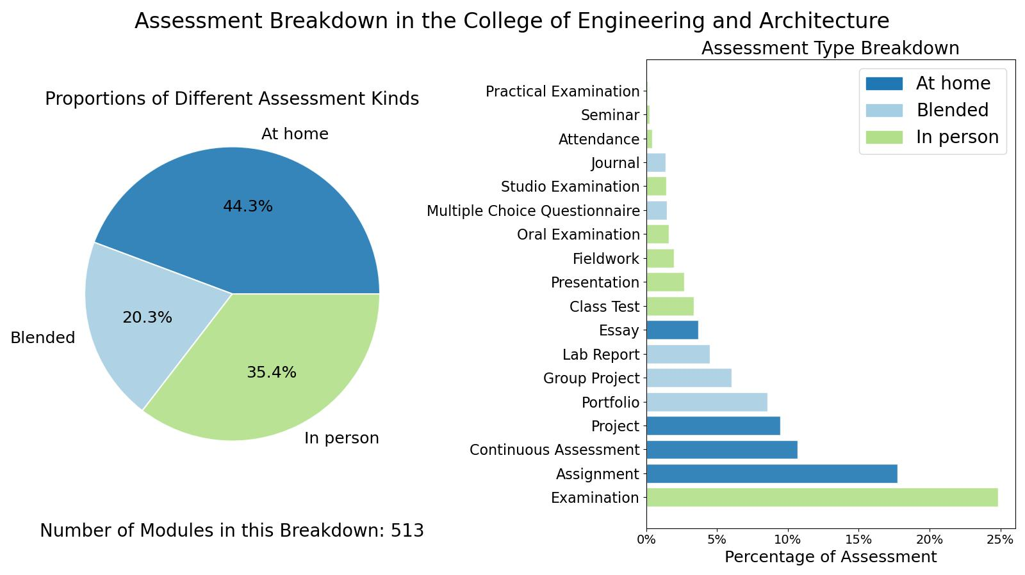
College of Engineering & Architecture

Slide 6
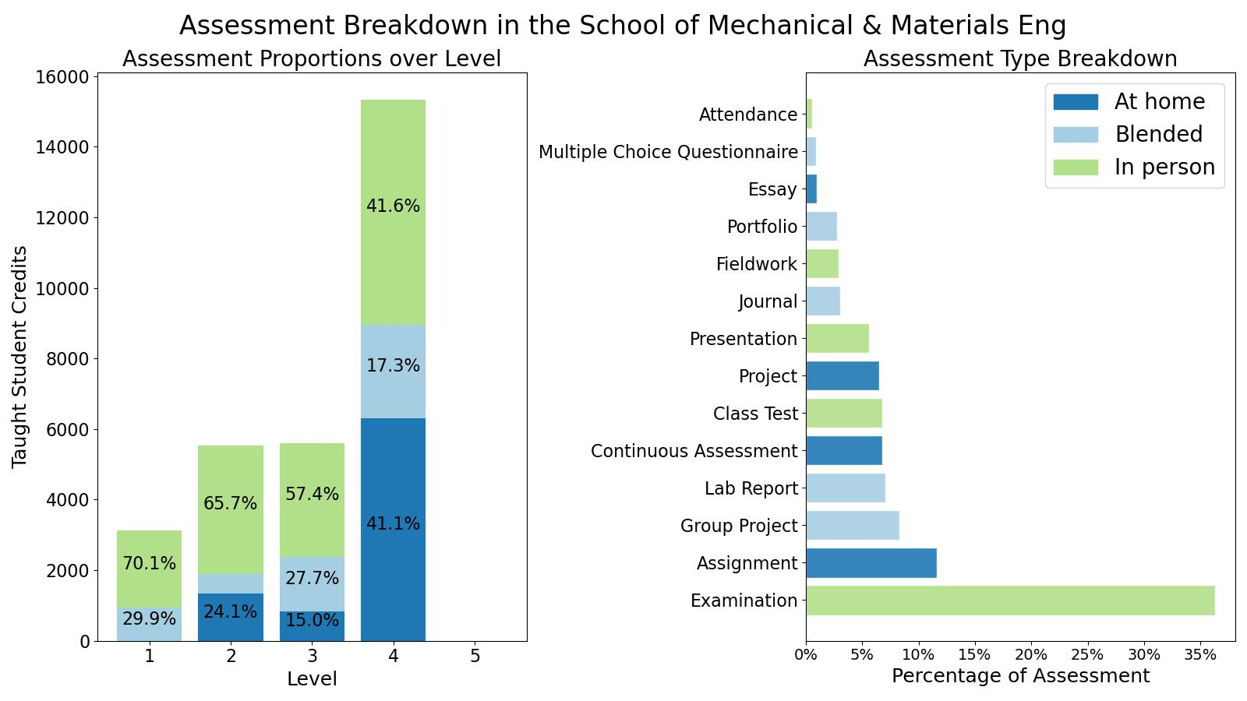
School of Mechanical & Materials Engineering

Slide 7
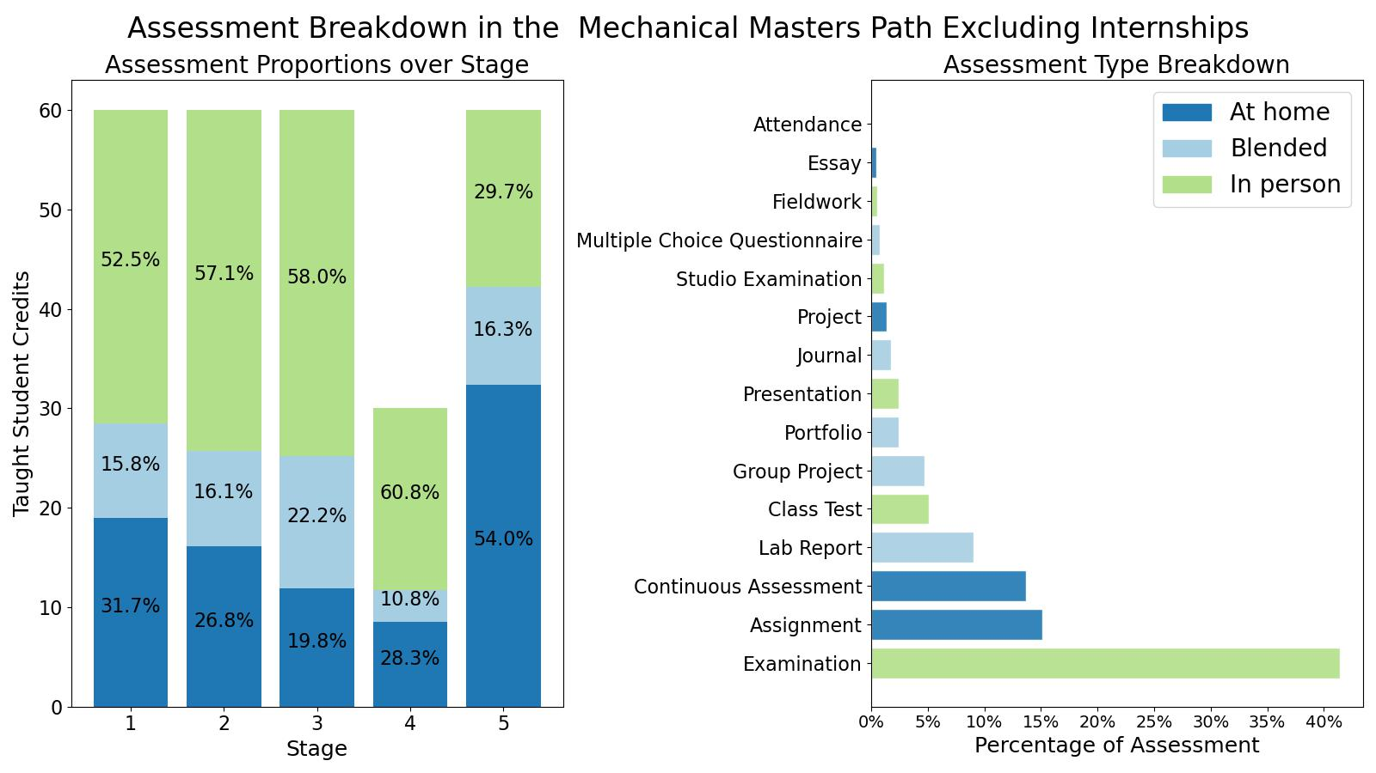
ME Mechanical Engineering

Slide 8
Assessment Strategy Overview School of Mechanical & Materials Engineering Assessment Integrity in the Era of Large Language Models: Threats and Opportunities within the UCD College of Engineering & Architecture June 2023

